Slide 1
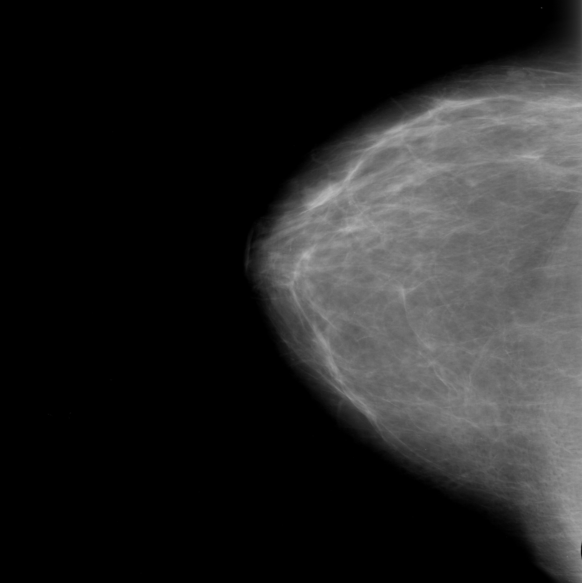
Convolutional +ReLU Layer
Max Pooling Layer
Dense + ReLU Layer
None,2
None,128
None,93312
55 x 55 x 64
27 x 27 x 128
None,512
224 x 224 x 32
55 x 55 x 128
55 x 55 x 128
112 x 112 x 32
55 x 55 x 128
112 x 112 x 64
Dense + Softmax Layer
Flatten Layer

Slide 2
Convolutional +ReLU Layer
Max Pooling Layer
Dense + ReLU Layer
Input
Dense + Softmax Layer
None,512
None,512
None,2
55 x 55 x 64
None,93312
None,256
55 x 55 x 128
None,128
None,256
224 x 224 x 32
55 x 55 x 128
None,128
112 x 112 x 32
55 x 55 x 128
112 x 112 x 64
55 x 55 x 128
27 x 27 x 128
Flatten Layer
Batch Normalization Layer

Slide 3
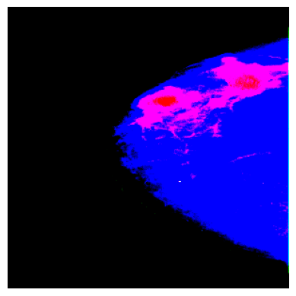
Mass 89%
Mass 89%

Slide 4
P5
P4
P3
P2
P1

Slide 5
Detect
Detect
Detect
320 x 320 x 64 x w
160 x 160 x 128 x w
160 x 160 x 128 x w
80 x 80 x 256 x w
80 x 80 x 256 x w
40 x 40 x 512 x w
40 x 40 x 512 x w
20 x 20 x 512 x w x r
20 x 20 x 512 x w x r
20 x 20 x 512 x w x r
40 x 40 x 512 x w x r
40 x 40 x 512 x w x r x (1+r)
40 x 40 x 512 x w
80 x 80 x 256 x w
80 x 80 x 256 x w
80 x 80 x 256 x w
40 x 40 x 256 x w
40 x 40 x 512 x w
40 x 40 x 512 x w
20 x 20 x 512 x w x r
20 x 20 x 512 x w x r x (1+r)
20 x 20 x 512 x w

Slide 6
Detect
320 x 320 x 64 x w
160 x 160 x 128 x w
160 x 160 x 128 x w
80 x 80 x 256 x w
80 x 80 x 256 x w
40 x 40 x 512 x w
40 x 40 x 512 x w
20 x 20 x 512 x w x r
20 x 20 x 512 x w x r
20 x 20 x 512 x w x r
40 x 40 x 512 x w x r
40 x 40 x 512 x w x r x (1+r)
40 x 40 x 512 x w
80 x 80 x 256 x w
80 x 80 x 256 x w
80 x 80 x 256 x w
40 x 40 x 256 x w
40 x 40 x 512 x w
40 x 40 x 512 x w
20 x 20 x 512 x w x r
20 x 20 x 512 x w x r x (1+r)
20 x 20 x 512 x w

Slide 7
Convolutional Layer
Convolution to Flatten Layer
Spatial Pyramid Feature Fusion Layer
Upsample Layer
Concat Layer

Slide 8
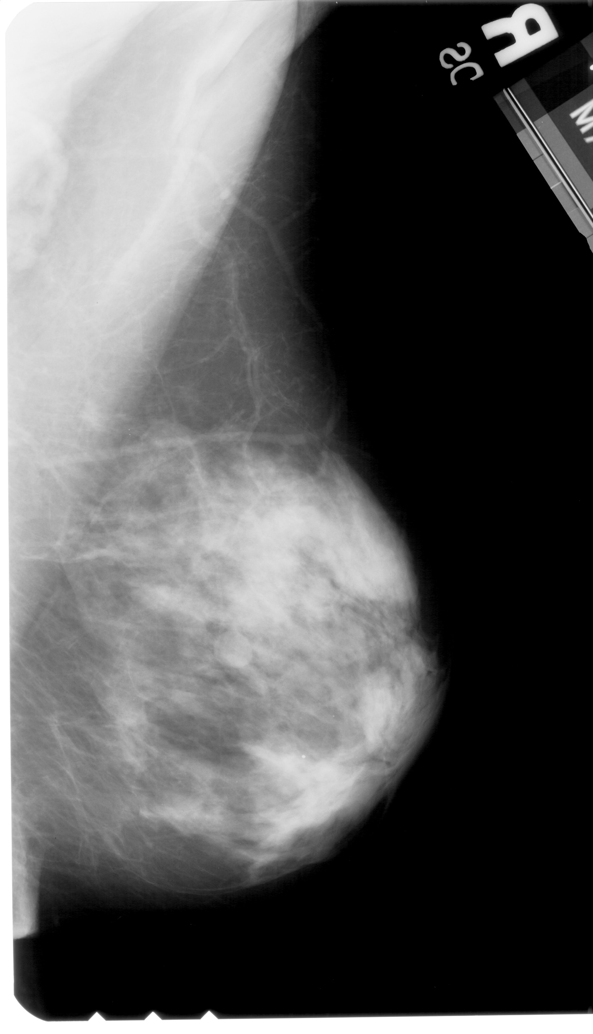
High Intensity Label
Background Region
High Density
(Can be a tumour)
Pectoral Muscle

